Slide 1
Convolutional Neural Networks (CNNs)
Generated for: Convolutional Neural Networks (CNNs), Introduction to CNNs, Convolution Operation, Pooling Layers, CNN Architecture Example, Applications of CNNs
Notes:
Welcome to the Convolutional Neural Networks (CNNs) presentation covering multiple topics. Today we'll explore: Convolutional Neural Networks (CNNs), Introduction to CNNs, Convolution Operation, Pooling Layers, CNN Architecture Example, Applications of CNNs.

Slide 2
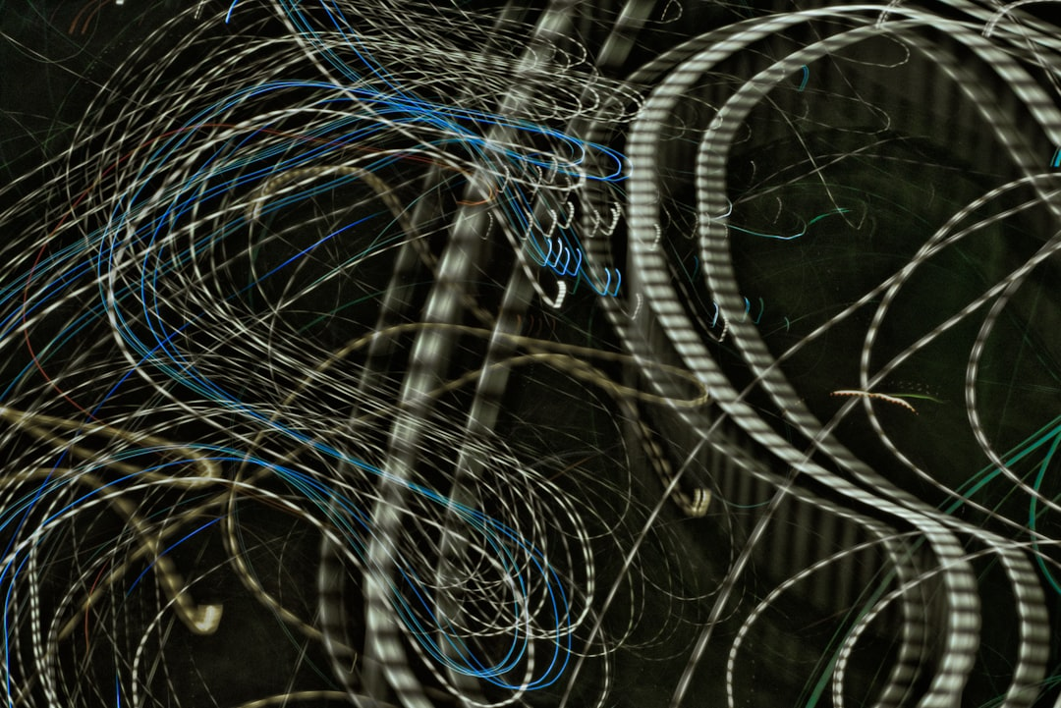
Convolutional Neural Networks (CNNs) - Introduction
CNNs are deep learning models for image classification tasks
Inspired by human visual cortex structure and function
Use convolutional and pooling layers for feature extraction
Effective for image recognition, object detection, segmentation
Key applications in self-driving cars, facial recognition
CNNs learn spatial hierarchies of features from images
Can be trained on large datasets like ImageNet, CIFAR-10
LeNet-5, AlexNet, VGG16 are notable CNN architectures
Convolutional layers use filters for feature detection
Activation functions introduce non-linearity in models
Notes:
When introducing CNNs, emphasize their inspiration from the human visual cortex and their ability to learn spatial hierarchies of features from images. Give examples of key applications such as self-driving cars and facial recognition. Explain that CNNs are effective for image recognition, object detection, and segmentation tasks. Discuss the importance of large datasets like ImageNet and CIFAR-10 for training CNNs. Ask students to consider how CNNs can be applied to real-world problems and what the limitations of these models might be. Key takeaways should include understanding the basic architecture of CNNs and their ability to learn features from images.

Slide 3
Convolutional Neural Networks (CNNs) - Architecture
CNNs consist of convolutional and pooling layers
Convolutional layers extract local features
Pooling layers reduce spatial dimensions
Fully connected layers for classification
Activation functions introduce non-linearity
ReLU is a commonly used activation function
Batch normalization improves training speed
Dropout prevents overfitting in networks
y = σ(Wx + b) is a basic neural equation
Notes:
When explaining the architecture of CNNs, emphasize the role of each layer type. Discuss how convolutional layers are crucial for feature extraction, while pooling layers help in reducing the dimensionality of the data. Highlight the importance of activation functions like ReLU in introducing non-linearity. Provide examples of how these concepts are applied in real-world image classification tasks. Ask students to consider how the architecture of a CNN might be modified for different applications, such as object detection or image segmentation. Key takeaways should include understanding the basic components of a CNN and their functions, as well as how these components work together to enable complex image recognition tasks.

Slide 4
Convolutional Neural Networks (CNNs) - Architecture
Convolutional layers extract local features from inputs
Pooling layers reduce spatial dimensions of data
Flatten layers transform data into 1D arrays
Dense layers perform classification or regression tasks
Activation functions introduce non-linearity to models
ReLU is a commonly used activation function
Batch normalization improves model stability
Dropout prevents overfitting by randomizing weights
CNNs use y = σ(Wx + b) for predictions
Strided convolutions enhance feature extraction
Notes:
When discussing the architecture of CNNs, emphasize the role of each layer in the network. Explain how convolutional layers use filters to extract features, and how pooling layers reduce the spatial dimensions of the data. Provide examples of how dense layers are used for classification or regression tasks. Use the equation y = σ(Wx + b) to illustrate the prediction process. Ask students to consider how the choice of activation function, such as ReLU, affects the model's performance. Key takeaways include understanding the purpose of each layer and how they work together to enable CNNs to learn complex patterns in data.

Slide 5
Introduction to CNNs - Introduction
Convolutional Neural Networks process visual data efficiently
Inspired by biological neural networks in the brain
Used for image classification and object detection tasks
Key component in deep learning and computer vision
Consist of convolutional and pooling layers
Apply filters to small regions of input data
Enable spatial hierarchies of features to be learned
Trainable via backpropagation and optimization algorithms
Common applications in self-driving cars and facial recognition
Notes:
When introducing CNNs, emphasize their ability to process visual data efficiently, inspired by biological neural networks. Give examples of applications in image classification and object detection, such as self-driving cars and facial recognition. Ask students if they have any experience with image processing or deep learning. Key takeaways include understanding the basic architecture of CNNs and their importance in computer vision. Provide a simple example of a convolutional layer, such as applying a filter to an image, to illustrate the concept.

Slide 6
Introduction to CNNs - Introduction
Convolutional Neural Networks (CNNs) are deep learning models
Inspired by biological neural networks and visual cortex
Primarily used for image and video processing tasks
CNNs consist of convolutional and pooling layers
Convolutional layers apply filters to input data
Pooling layers reduce spatial dimensions of data
CNNs can learn spatial hierarchies of features
Key applications include image classification and object detection
CNNs have achieved state-of-the-art results in many tasks
Example: self-driving cars use CNNs for vision processing
Notes:
When introducing CNNs, explain the biological inspiration behind them and their primary applications. Provide examples of how CNNs are used in real-world tasks, such as image classification and object detection. Ask students to consider how CNNs can be applied to various fields, including healthcare and transportation. Emphasize the importance of understanding the architecture of CNNs, including convolutional and pooling layers, to appreciate their capabilities and limitations. Encourage students to think critically about the potential applications and challenges of using CNNs in different contexts.

Slide 7
Introduction to CNNs - Architecture
CNNs consist of convolutional and pooling layers
Convolutional layers apply filters to input data
Pooling layers reduce spatial dimensions
Fully connected layers enable classification
ReLU activation function introduces non-linearity
Sigmoid function used for binary classification
CNNs use backpropagation for training
Architecture designed for image processing
Example: LeNet-5 for handwritten digit recognition
y = σ(Wx + b) simple neural network equation
Notes:
Explain the basic architecture of CNNs, highlighting the roles of convolutional, pooling, and fully connected layers. Discuss the importance of activation functions like ReLU and sigmoid. Provide examples of CNN applications, such as image classification and object detection. Ask students to consider how CNNs can be used in real-world scenarios, such as self-driving cars or medical image analysis. Key takeaways include understanding the components of a CNN and their functions, as well as the ability to apply CNNs to various problems.

Slide 8
Convolution Operation - Introduction
Convolution operation is key in CNNs for image processing
Extracts features from small image regions using filters
Filters scan images in horizontal and vertical strides
Output feature maps represent convolved image sections
Convolution helps in reducing spatial dimensions
Preserves important information with shared weights
Reduces number of parameters with weight sharing
Enables equivariance to translation and rotation
Used in various applications like image classification
Notes:
When introducing the convolution operation, explain its significance in CNNs for image processing tasks. Provide examples of how filters are used to extract features from small regions of an image. Emphasize the concept of weight sharing and how it reduces the number of parameters, making the model more efficient. Ask students to consider how convolution enables equivariance to translation and rotation. Key takeaways should include understanding the role of convolution in reducing spatial dimensions while preserving important information.

Slide 9
Convolution Operation - Introduction
Convolution combines image data with filter kernels
Extracts features from small image regions
Applies filters to detect edges and lines
Convolutional layers process data spatially
Filters slide over entire image
Performing dot product at each position
Resulting feature maps capture local patterns
Activation functions introduce non-linearity
Enhancing feature extraction capabilities
Notes:
When introducing the convolution operation, explain how it's a fundamental component of Convolutional Neural Networks (CNNs). Provide examples of how convolution is used in image processing, such as edge detection and feature extraction. Ask students to consider how the size and shape of filters affect the output. Emphasize the importance of convolution in enabling CNNs to automatically and adaptively learn spatial hierarchies of features from images. Discuss how the convolution operation is a key factor in the success of CNNs in various computer vision tasks.

Slide 10
Convolution Operation - Introduction
Convolution operation is a fundamental component of CNNs.
It extracts features from input data using filters.
Filters scan input data in both horizontal and vertical directions.
Convolution operation reduces spatial dimensions of data.
It preserves spatial relationships between neighboring pixels.
Stride and padding control output spatial dimensions.
Convolution operation is followed by activation function.
ReLU is commonly used activation function in CNNs.
Convolution operation is used in image classification tasks.
Example: Image classification using convolution operation.
Notes:
When explaining the convolution operation, emphasize its importance in CNNs and how it extracts features from input data. Provide examples of how filters scan input data and how stride and padding control output spatial dimensions. Ask students to consider how the convolution operation preserves spatial relationships between neighboring pixels. Key takeaways include understanding the role of convolution operation in reducing spatial dimensions of data and its application in image classification tasks. Discuss how ReLU is commonly used as an activation function after convolution operation.

Slide 11
Pooling Layers - Introduction
Reduce spatial dimensions of feature maps
Downsample data to decrease parameters
Increase translation invariance in models
Typically applied after convolutional layers
Max pooling and average pooling exist
Max pooling selects maximum value
Average pooling calculates mean value
Helps prevent overfitting in deep models
Improves robustness to small transformations
Notes:
Explain that pooling layers are essential components of convolutional neural networks, used to reduce the spatial dimensions of feature maps. Discuss how max and average pooling work, and provide examples of their applications. Emphasize the importance of pooling layers in preventing overfitting and improving model robustness. Ask students to consider the trade-offs between max and average pooling, and how they impact model performance. Key takeaway: pooling layers are crucial for efficient and effective convolutional neural network design.

Slide 12
Pooling Layers - Introduction
Reduces spatial dimensions of feature maps
Downsamples data to reduce parameters
Helps prevent overfitting in CNNs
Max pooling is most commonly used
Average pooling also used in some cases
Pooling layer is applied after convolution
Reduces number of parameters to compute
Improves translation invariance in images
Enhances robustness to small transformations
Notes:
When introducing pooling layers, explain how they reduce spatial dimensions and prevent overfitting. Provide examples of max and average pooling, and discuss their applications in CNNs. Ask students to consider how pooling layers impact translation invariance and robustness. Emphasize key takeaways, such as reduced parameters and improved generalization.

Slide 13
Pooling Layers - Introduction
Reducing spatial dimensions of data with pooling layers
Downsampling feature maps to retain key information
Helping to prevent overfitting in CNN models
Typically applied after convolutional layers
Max pooling extracts maximum value from regions
Average pooling calculates mean value from regions
Pooling layers reduce number of parameters needed
Improving translation invariance in CNNs
Enabling use of larger convolutional filters
Preserving important features in images
Notes:
When introducing pooling layers, explain their role in reducing spatial dimensions and preventing overfitting. Provide examples of max and average pooling, and ask students to consider the impact of different pooling strategies on model performance. Key takeaways include the importance of downsampling and the types of pooling layers, such as max and average pooling. Discuss how pooling layers contribute to translation invariance and the ability to use larger convolutional filters, highlighting their significance in CNN architecture.

Slide 14
CNN Architecture Example - Introduction
Convolutional Neural Networks process visual data
CNNs consist of convolutional and pooling layers
Activation functions introduce non-linearity
Flatten layer reshapes output for dense layers
Dense layers enable classification or regression
LeNet-5 is a basic CNN architecture example
AlexNet is a deeper CNN architecture example
VGGNet uses smaller filters for convolution
ResNet introduces residual connections for deep learning
Notes:
When introducing the CNN architecture example, explain the basic components of a CNN, including convolutional, pooling, and dense layers. Provide examples of well-known CNN architectures like LeNet-5, AlexNet, and ResNet. Ask students to consider the advantages of using smaller filters in VGGNet. Emphasize the importance of non-linearity introduced by activation functions. Key takeaways include understanding the role of each layer type and how different architectures address deep learning challenges.

Slide 15
CNN Architecture Example - Introduction
Convolutional Neural Networks use convolutional layers
Convolutional layers extract local features from data
Pooling layers reduce spatial dimensions of data
Fully connected layers classify output data
Activation functions introduce non-linearity to data
ReLU is a commonly used activation function
CNNs are widely used in image classification tasks
Example: handwritten digit recognition using MNIST
Equation: y = σ(Wx + b) for neural network layer
Notes:
Explain the basic components of a CNN architecture, including convolutional, pooling, and fully connected layers. Provide examples of how CNNs are used in image classification tasks, such as handwritten digit recognition using the MNIST dataset. Discuss the importance of activation functions, like ReLU, in introducing non-linearity to the data. Ask students to consider how CNNs can be applied to real-world problems, such as object detection or image segmentation. Key takeaway: CNNs are a powerful tool for image classification and can be used in a variety of applications.

Slide 16
CNN Architecture Example - Applications
Image classification using CNNs for self-driving cars
Object detection in surveillance systems with YOLO
Facial recognition with convolutional layers
Medical image analysis for disease diagnosis
Segmentation of images for autonomous robots
CNNs in natural language processing for text analysis
Convolutional autoencoders for image compression
Transfer learning with pre-trained CNN models
Real-time video processing with CNN architectures
Image generation using Generative Adversarial Networks
Notes:
When discussing CNN architecture examples, emphasize the diversity of applications. Provide examples of how CNNs are used in image classification, object detection, and facial recognition. Ask students to consider the benefits of using pre-trained models and transfer learning. Key takeaways include understanding the versatility of CNNs and their ability to be applied across various domains, from computer vision to natural language processing.

Slide 17
Applications of CNNs - Introduction
Convolutional Neural Networks (CNNs) for image classification
CNNs used in object detection and recognition systems
Image segmentation and generation with CNNs
CNN applications in medical imaging and diagnostics
Self-driving cars utilize CNNs for scene understanding
Facial recognition systems rely on CNNs for identification
CNNs applied in natural language processing tasks
Robotics and autonomous systems use CNNs for perception
Surveillance systems leverage CNNs for anomaly detection
CNNs enable intelligent video analysis and monitoring
Notes:
When introducing the applications of CNNs, emphasize their versatility and widespread adoption across various fields. Provide examples of how CNNs are used in real-world scenarios, such as self-driving cars and medical imaging. Ask students to consider the potential applications of CNNs in their own areas of interest. Key takeaways include the ability of CNNs to learn complex patterns in data and their ability to be applied to a wide range of tasks, from image classification to natural language processing.

Slide 18
Applications of CNNs - Introduction
Image classification: object detection, facial recognition
Object detection: self-driving cars, surveillance systems
Image segmentation: medical imaging, autonomous vehicles
Natural language processing: text classification, sentiment analysis
Speech recognition: voice assistants, transcription services
Time series forecasting: stock prices, weather prediction
Recommendation systems: e-commerce, content streaming
Medical diagnosis: disease detection, tumor segmentation
Robotics: robotic vision, control systems
Autonomous systems: drones, self-driving cars
Notes:
When introducing applications of CNNs, emphasize the versatility of these networks across various domains. Provide examples such as how image classification is used in facial recognition and object detection in self-driving cars. Ask students to consider how CNNs can be applied to real-world problems, such as medical diagnosis or natural language processing. Key takeaways include understanding the breadth of CNN applications and their potential to solve complex problems. Encourage students to think about potential projects or research areas where CNNs could be applied.

Slide 19
Applications of CNNs - Applications
Image classification with CNNs achieves high accuracy
Object detection for self-driving cars and robots
Facial recognition for security and surveillance
Medical image analysis for diagnosis and treatment
Image segmentation for satellite and drone imaging
CNNs used in natural language processing tasks
Speech recognition with convolutional neural networks
Time series forecasting with CNN architectures
Recommendation systems utilizing CNN models
Enhancing CNNs with transfer learning techniques
Notes:
When discussing the applications of CNNs, emphasize the versatility and wide range of tasks they can perform. Provide examples such as image classification, object detection, and facial recognition, highlighting their impact on real-world problems. Ask students to consider how CNNs can be applied to their own research interests or projects. Key takeaways include understanding the breadth of CNN applications and their potential to drive innovation in various fields.

